Slide 1

BASIC NETWORKING
prepared by: Khoi Nguyen
presented date: Dec 23, 2008

Slide 2

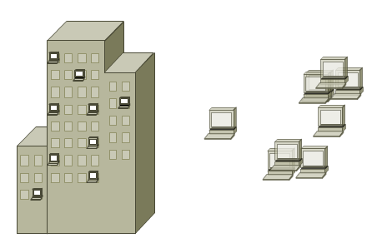
Evolution of Networking (1)
Individual Computers

Slide 3
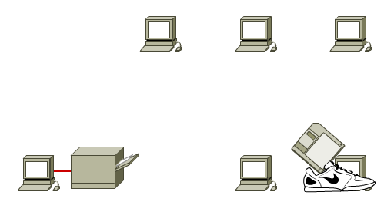
Evolution of Networking (2)
Duplicate equipment and resources
Difficult to communicate
Difficult to provide management

Slide 4
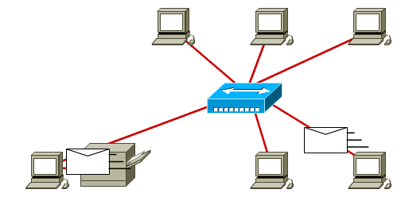
Evolution of Networking (3)
LAN: Local Area Network

Slide 5
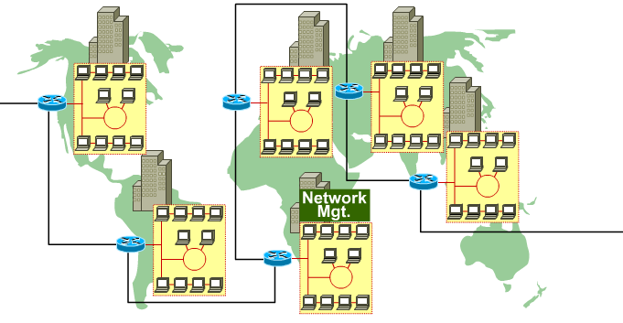
Evolution of Networking (4)
WAN: Wide Area Network

Slide 6
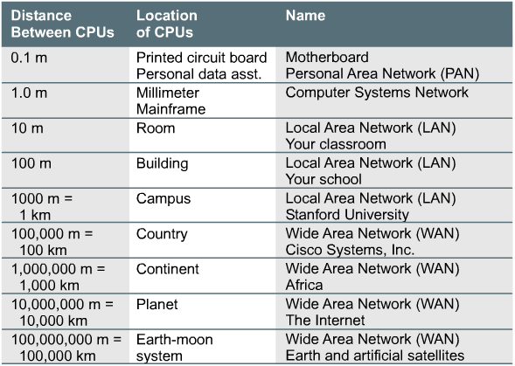
Data Networks

Slide 7
LAN = Local Area Network
Connect physically adjacent devices
Operate within a limited geographic area
High-bandwidth media
Full-time connectivity
Control the network privately

Slide 8
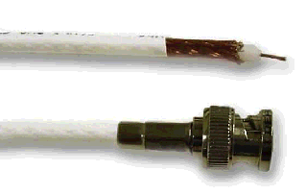
LAN Media: Coaxial Cable
10Base2
10Base5

Slide 9
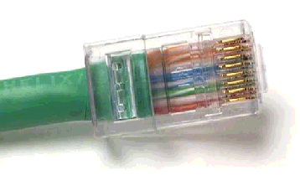
LAN Media: UTP & STP
10BaseT
100BaseTX

Slide 10
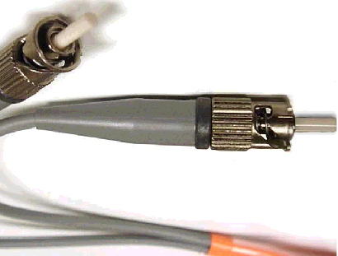
LAN Media: Fiber Optic
100BaseFX
1000BaseLX

Slide 11


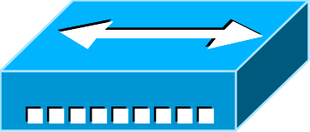

LAN Equipments
Bridge
Repeater
Router
HUB
LAN Switch

Slide 12
WAN = Wide Area Network
Devices separated over wide areas
Operate over large geographical area
Slow speed
Full-time and Part-time connectivity

Slide 13
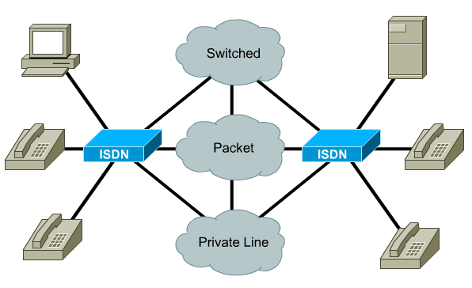
WAN Media: Circuit Switching
Telephone network or ISDN

Slide 14
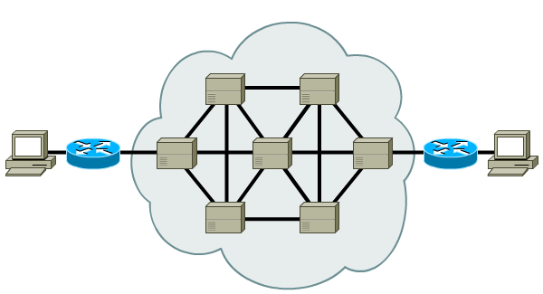
WAN Media: Packet/Cell Switching
Frame Relay, X25, ATM

Slide 15
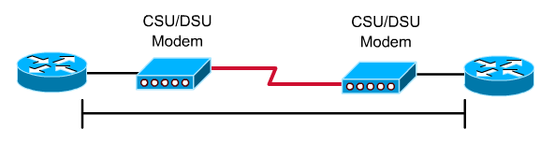
WAN Media: Dedicated Line
Full-time connectivity

Slide 16

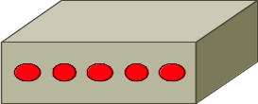

WAN Equipments
Modem/TA
WAN/packet switch
Router
Communication Server

Slide 17
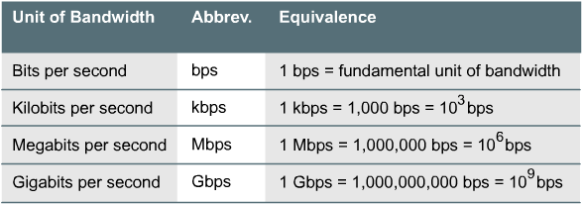
Digital Bandwidth
How much information can flow from one place to another in a given amount of time.

Slide 18
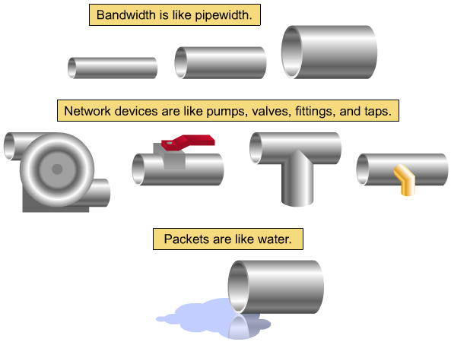
Analogy for Bandwidth: Pipe

Slide 19
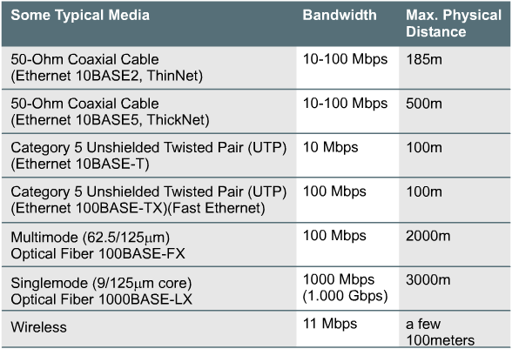
Bandwidth: LAN Media

Slide 20
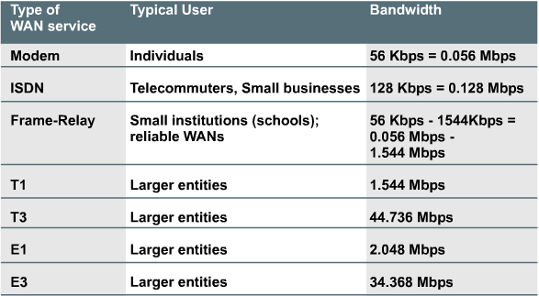
Bandwidth: WAN Services

Slide 21
Throughput
<= Bandwidth
Throughput refers to actual, measured, bandwidth, at a specific time of day.
The throughput is effected by:
  Internetworking devices
  Type of data being transferred
  Topology
  Number of users
  User's computer
  Server computer
  Power and weather-induced outages

Slide 22
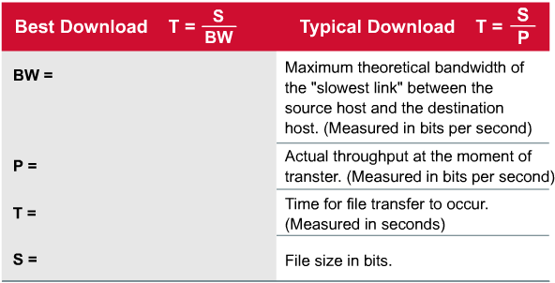
Time Calculations

Slide 23
Physical Topology

Slide 24
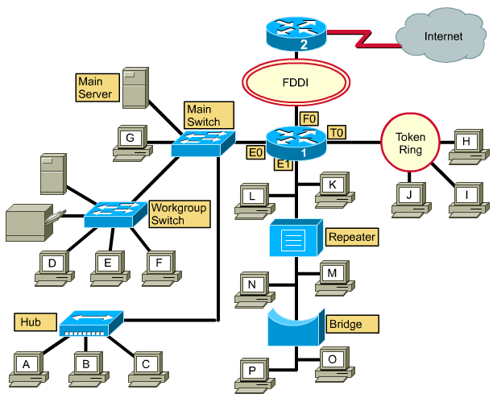
Are you able to describe this diagram?

Slide 25
Physical & Logical Topologies
Physical topologies
  Define the actual layout of the wire (media)
Logical topologies
  Define how the media is accessed by the hosts

Slide 26





Physical Topologies
Extended
Star
Bus
Ring
Star
Mesh

Slide 27
Physical Topology: Bus
Single backbone
All hosts directly connected to backbone
Each end of the bus must be properly terminated

Slide 28
Physical Topology: Ring
No backbone
A host is directly connected to each of its neighbors

Slide 29
Physical Topology: Star
All devices connected to a central point
Center of star is usually a hub or a switch

Slide 30
Physical Topology: Extended Star
Connects individual star topologies together.
At the center of the star is a hub or a switch.
Extends the length and size of the network.

Slide 31

Physical Topology: Mesh
Each host has its own connection to every other host.
Used in situations where communication must not be interrupted.

Slide 32
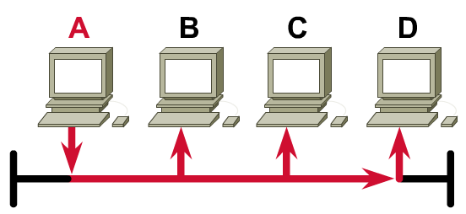
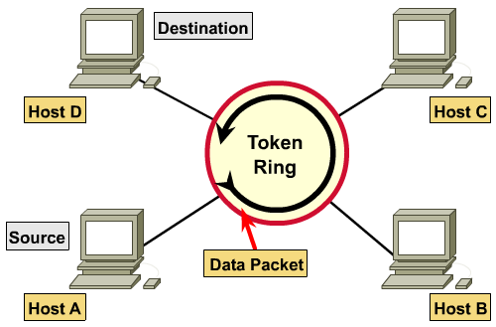
Logical Topologies
Broadcast
Token Passing

Slide 33
Logical Topology: Broadcast
Each host on the LAN sends its data (or broadcasts its data) to every other host.
First-come, first-serve.

Slide 34
Logical Topology: Token Passing
Access to media is controlled by an electronic token.
Possession of the token gives the host the right to pass data to its destination.

Slide 35

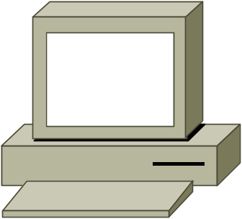
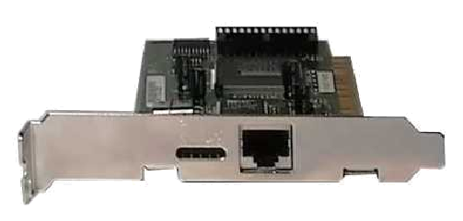
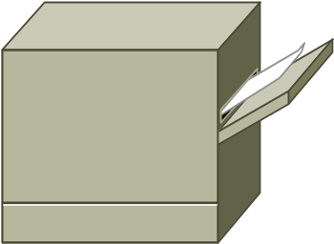
Hosts
NIC
Computer
Server
Printer

Slide 36
LAN Media Symbols
Ethernet
Line
Token
Ring
Serial
Line
FDDI
Ring

Slide 37
OSI Review: Layer 1
Responsibility:
  Transmission of an unstructured bit stream over a physical link between end systems.
Concerned:
  Bits.
  Electrical specifications.
  Physical data rate.
  Distances.
  Physical connector.

Slide 38
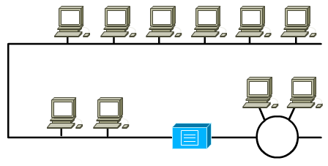
LAN Device: Repeater
Regenerates and repeats the signal.
Layer 1 device.

Slide 39
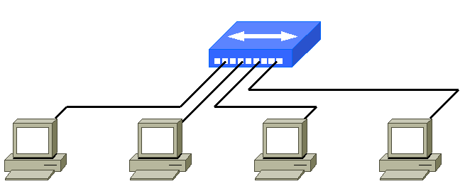
LAN Device: Hub
A multi-port repeater.
Layer 1 device.

Slide 40
OSI Review: Layer 2
Responsibility:
  Provides for the reliable transfer of data cross a physical link.
Concerned:
  Frames.
  Physical address (HW or MAC)
  Line discipline.
  Error and flow control.
  “Segment”

Slide 41
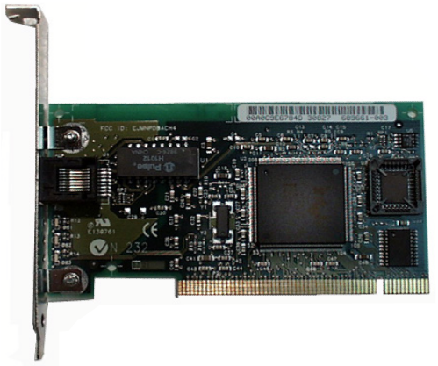
LAN Device: NIC
Network interface of hosts.
Build-in physical address.
Layer 2 device.

Slide 42
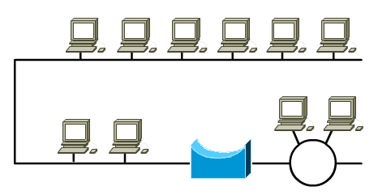
LAN Device: Bridge
Keeps traffic local by filtering traffic based on physical addresses.
Layer 2 device.

Slide 43
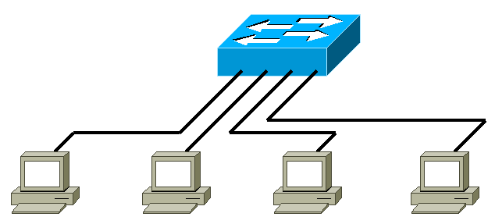
LAN Device: Switch
A multi-port bridge.
Layer 2 device.

Slide 44
OSI Review: Layer 3
Responsibility:
  Connection and path selection between two end system across networks.
Concerned:
  Packets.
  Logical address: Hierarchical.
    Networks and Hosts addressing.
  Route , Routing table, Routing protocol.
  “Network”.

Slide 45





LAN Device: Router
Makes decisions based on network addresses (logical addresses).
Layer 3 device.

Slide 46
LAN Device: Router Functions
Path determination:
  The process of evaluating a packet’s destination IP address so that the router can decide which port to send out the packet.
Packet switching:
  The router re-encapsulates the packet in the protocol needed for the specified port and then switches the packet out that port.

Slide 47

LAN Device: Cloud
Another network
Include layer 1 – 7 devices

Slide 48
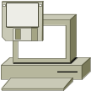




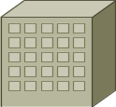
Cabling the Campus
Legend
FastEthernet/
Ethernet
ISDN
Dedicated
Core_Server
core_sw_a
Leased Line/
Frame Relay
ISDN Cloud

Slide 49
UTP Device
Wire Pair
T is Tip
R is Ring
Pin
1
Pair 3 T2
2
Pair 3 R2
1
3
Pair 2 T3
4
Pair 1 R1
8
5
Pair 1 T1
6
Pair 2 R3
7
Pair 4 T4
The RJ-45 Connector
8
Pair 4 R4

Slide 50

UTP Implementation Straight-through
Cable 10BaseT/
100BaseTx Straight-through
Straight-through Cable
8
1
Hub/Switch
Server/Router
Pin Label
1 RD+
2 RD-
3 TD+
4 NC
5 NC
6 TD-
7 NC
8 NC
Pin Label
1 TD+
2 TD-
3 RD+
4 NC
5 NC
6 RD-
7 NC
8 NC
1
8
1
8
1
8
w
g
g
w
o
b
w
b
o
w
br
w
g
br
g
w
o
b
w
b
o
w
br
br
Wires on cable ends are in same order

Slide 51
UTP Implementation Crossover
Cable 10BaseT/
100BaseT Crossover
Crossover Cable
Hub/Switch
Hub/Switch
8
1
Pin Label
1 RD+
2 RD-
3 TD+
4 NC
5 NC
6 TD-
7 NC
8 NC
Pin Label
1 RD+
2 RD-
3 TD+
4 NC
5 NC
6 TD-
7 NC
8 NC
1
8
8
1
8
1
w
b
w
g
w
br
w
o
w
b
br
b
o
g
Some wires on cable ends are crossed
br
w
br
g
b
w
g
o
w
o

Slide 52

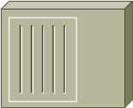


Cabling the Campus
  Determine the physical media used- 10MB or 100MB
    Indicates what type of CAT cable is required
  Locating interfaces on the chassis- determine if one
  or both ports have an X
    Indicates if need crossover or straight-through cable
100 Mbps
Cat 5
Crossover
10 Mbps
Cat 3, 4, 5
Crossover
10 Mbps
Cat 3, 4, 5
Straight-through
10 Mbps
Cat 3, 4, 5
Straight-through
100 Mbps
Cat 5
Straight-through

Slide 53
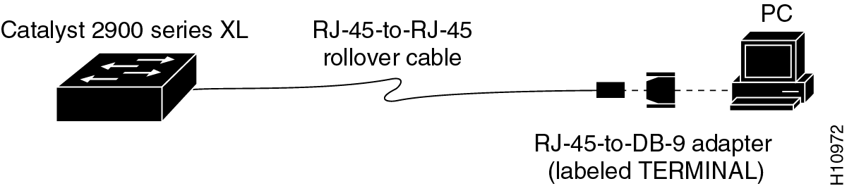
Setting up a Console Connection
Device with console
  PCs require an RJ-45 to DB-9 or RJ-45 to DB-25 adapter
  COM port settings are 9600 bps, 8 data bits, no parity, 1 stop bit, no flow control
  This provides out-of-band console access

Slide 54
OSI AND TCP/IP MODEL

Slide 55
OSI MODEL

Slide 56
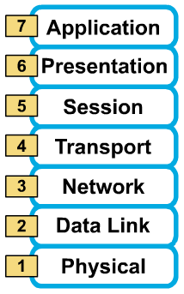
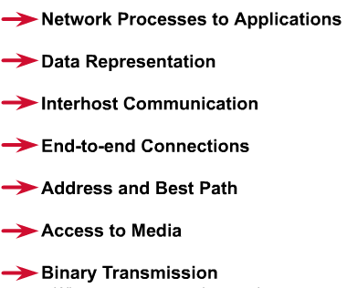
7 layers of the OSI reference model
Layer 7: Application
Layer 6: Presentation
Layer 5: Session
Layer 4: Transport
Layer 3: Network
Layer 2: Data Link
Layer 1: Physical

Slide 57
The physical layer
Transmission of an unstructured bit stream over a physical link between end systems.
  Electrical, mechanical, procedural and functional specifications
  Physical data rate
  Distances
  Physical connector

Slide 58
The data-link layer
Provides for the reliable transfer of data cross a physical link.
  Frames
  Physical address
  Network topology
  Line discipline
  Synchronization
  Error control
  Flow control

Slide 59
The network layer
Provides connectivity and path selection between two host systems that may be located on geographically separated networks.
  Packets
  Virtual circuits
  Route, routing table, routing protocol
  Logical address
  Fragmentation

Slide 60
The transport layer
Provides reliable, transparent transfer of data over networks.
  Segments, data stream, datagram
  Connection oriented and connectionless
  End-to-end flow control
  Error detection and recovery
  Segmentation & reassembly

Slide 61
The session layer
Establishes, manages, and terminates sessions between two communicating hosts.
  Sessions
  Dialog
  Conversations
  Data exchange

Slide 62
The presentation layer
Ensures that the information that the application layer of one system sends out is readable by the application layer of another system.
  Format of data
  Data structure
  Data conversion
  Data compression
  Data encryption

Slide 63
The application layer
Is the OSI layer that is closest to the user; it provides network services to the user’s applications.
  File transfer
  Electronic mail
  Terminal access
  Word processing
  Intended communication partners

Slide 64
TCP/IP MODEL

Slide 65
TCP/IP model development
The late-60s The Defense Advance Research Projects Agency (DARPA) originally developed Transmission Control Protocol/Internet Protocol (TCP/IP) to interconnect various defense department computer networks.
The Internet, an International Wide Area Network, uses TCP/IP to connect networks across the world.

Slide 66
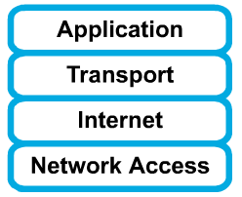
4 layers of the TCP/IP model
Layer 4: Application
Layer 3: Transport
Layer 2: Internet
Layer 1: Network access
It is important to note that some of the layers in the TCP/IP model have the same name as layers in the OSI model.
Do not confuse the layers of the two models.

Slide 67
The network access layer
Concerned with all of the issues that an IP packet requires to actually make the physical link. All the details in the OSI physical and data link layers.
  Electrical, mechanical, procedural and functional specifications.
  Data rate, Distances, Physical connector.
  Frames, physical addressing.
  Synchronization, flow control, error control.

Slide 68
The internet layer
Send source packets from any network on the internetwork and have them arrive at the destination independent of the path and networks they took to get there.
  Packets, Logical addressing.
  Internet Protocol (IP).
  Route , routing table, routing protocol.

Slide 69
The transport layer
The transport layer deals with the quality-of-service issues of reliability, flow control, and error correction.
  Segments, data stream, datagram.
  Connection oriented and connectionless.
  Transmission control protocol (TCP).
  User datagram protocol (UDP).
  End-to-end flow control.
  Error detection and recovery.

Slide 70
The application layer
Handles high-level protocols, issues of representation, encoding, and dialog control.
The TCP/IP combines all application-related issues into one layer, and assures this data is properly packaged for the next layer.
  FTP, HTTP, SMNP, DNS ...
  Format of data, data structure, encode …
  Dialog control, session management …

Slide 71
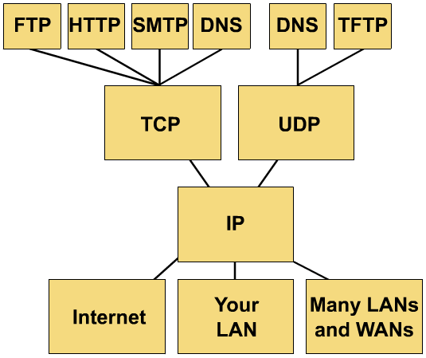
TCP/IP protocol stack

Slide 72
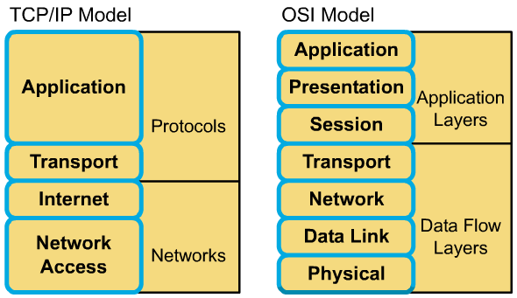
Comparing TCP/IP with OSI

Slide 73
Comparing TCP/IP with OSI (cont.)
Similarities:
  Both have layers.
  Both have application layers, though they include very different services.
  Both have comparable transport and network layers
  Packet-switched technology is assumed.
  Networking professionals need to know both.

Slide 74
Comparing TCP/IP with OSI (cont.)
Differences:
  TCP/IP combines the presentation and session layer issues into its application layer.
  TCP/IP combines the OSI data link and physical layers into one layer.
  TCP/IP appears simpler because it has fewer layers.
  Typically networks aren't built on the OSI protocol, even though the OSI model is used as a guide.

Slide 75
Thank you
Thanks for your attention!

